Slide 1


NOVEL EMBEDDED SYSTEM FOR REAL TIME FAULT DIAGNOSIS OF PHOTOVOLTAIC MODULES
DEPARTMENT OF ELECTRICAL AND ELECTRONICS ENGINEERING SAGI RAMA KRISHNAM RAJU ENGINEERING COLLEGE (AUTONOMOUS)
SUBMITTED BY
SINGANA LIKHIL SAI PRAKASH -21B91A02D4
SATTI DEVI SAI REDDY -21B91A02D2
PRAGADA VIJAYA RATHNANJALI -21B91A02C3
PILLI SATYA VENKAT -21B91A02B9
MOHAMMAD ANAS MALLIK -21B91A0295
UNDER THE ESTEEMED GUIDANCE OF Dr.B.S.S.SANTHOSH, M.Tech, Phd
ASSISTANT PROFESSOR

Slide 2
Abstract Block Diagram
Overview of Presentation
Current and Proposed model Technologies Used
Project status
Results&Testcases
References

Slide 3

ABSTRACT
The Novel Embedded System for Real-Time Fault Diagnosis of Photovoltaic Modules is designed to improve the efficiency and reliability of solar energy systems by enabling timely fault detection and diagnosis. The system utilizes an Raspberry PI microcontroller to monitor key parameters of photovoltaic (PV) modules, including voltage, current, solar irradiance, and environmental conditions such as temperature and humidity. Key sensors such as voltage and current sensors, an LDR sensor, and a DHT11 sensor work together to track the performance of the PV modules. The system operates using a 9V solar panel and a 12V battery, ensuring continuous power supply. Fault detection is achieved by analyzing deviations in electrical and environmental parameters, with notifications sent via SMS through a GSM module. Visual alerts are provided through LEDs, while a buzzer offers audio alerts when fault conditions are detected, ensuring quick response and maintenance. This system enhances the reliability of solar installations, preventing prolonged downtimes and optimizing energy generation.

Slide 4
BLOCK DIAGRAM
Solar panel
Raspberry PI
Pico
Servo Motor
Voltage sensor
LCD
Relay
DHT11 sensor
Buzzer
LDR Sensor
GSM
LED
MEMS Sensor
Water Pumping Motor

Slide 5



Vision
CURRENT MODEL :
Fault diagnosis of photovoltaic (PV) modules is often done manually or through basic monitoring systems that rely on periodic inspections and visual checks for issues like faulty connections, abnormal voltage, or environmental factors. These methods are time-consuming, inefficient, and lead to delayed responses, increasing downtime or reduced efficiency. Traditional systems lack real-time detection, remote communication, and automated alerts, and fail to monitor critical parameters like current, voltage, irradiance, and environmental conditions needed for accurate diagnosis.
PROPOSED MODEL :
The proposed method introduces a novel embedded system that provides real-time fault diagnosis for photovoltaic modules, enhancing both system efficiency and reliability. Using an Raspberry PI Pico microcontroller, the system continuously monitors key performance parameters such as voltage, current, solar irradiance, temperature, and humidity. Sensors including a voltage sensor, current sensor, LDR sensor, and DHT11 sensor work in tandem to assess module performance. The system alerts users of faults through visual indicators (LEDs) and audio signals (buzzer), while a GSM module sends SMS notifications for remote monitoring. The integration of a 9V solar panel and a 12V battery ensures continuous, autonomous operation. This approach facilitates timely fault detection, minimizes downtime, and optimizes the performance of photovoltaic systems.
Mission

Slide 6




Technolgies Used
programming Language used:
C++
Main sensors :
Voltage sensor
LDR sensor .
DHT11 sensor
MEMS sensor
:
Controller :
RASPBERRY PI Pico

Slide 7
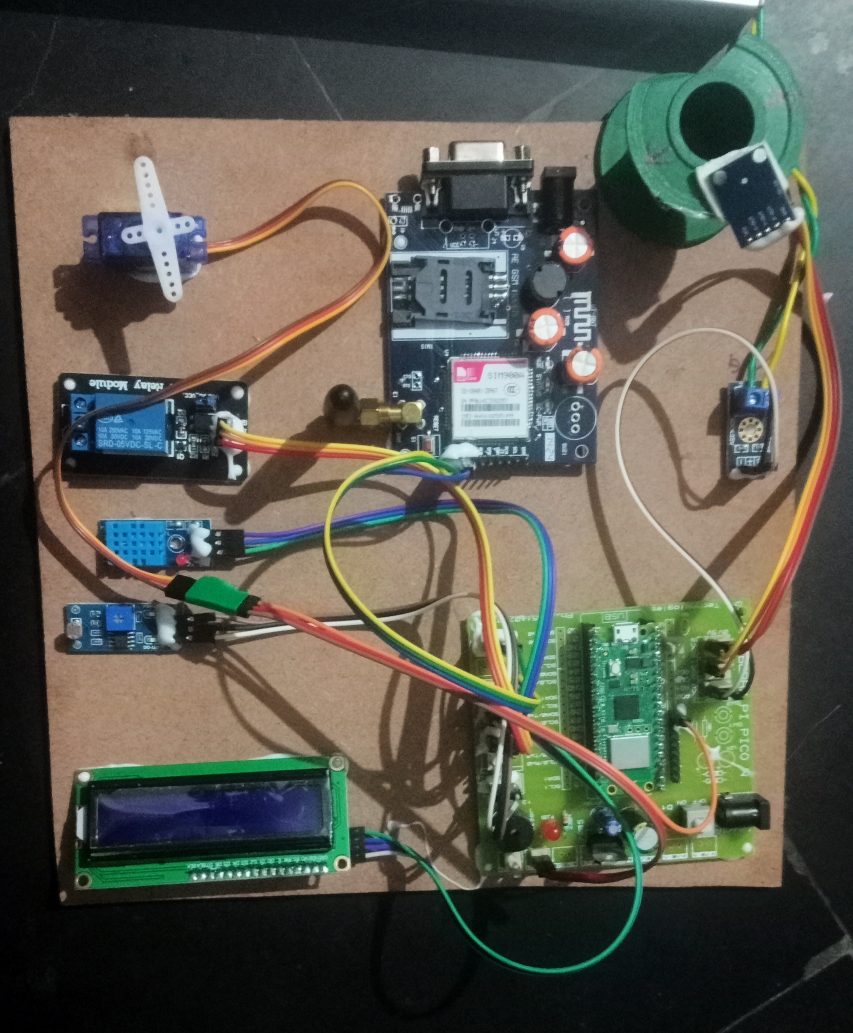

Present Project Status
Problem Identified : Need for a Embedded System for
photovoltaic module fault detection system
Solution Defined : Planned a device using Raspberry pi pico,
Gsm module, LED,Voltage sensor, DHT11, MEMS sensor ,
relay, servomotor.
Coding Completed : Developed and tested code in c++.
* Integrated Gsm module ,voltage , DHT11, MEMS
sensors with Raspberry pi pico.
Hardware Prototype completed : Basic functions tested and they are
working.
1.Alert sending through sms to client Mobile.
2.LCD displays the voltage or if anything unwanted occurs ,it
shows message sent.

Slide 8
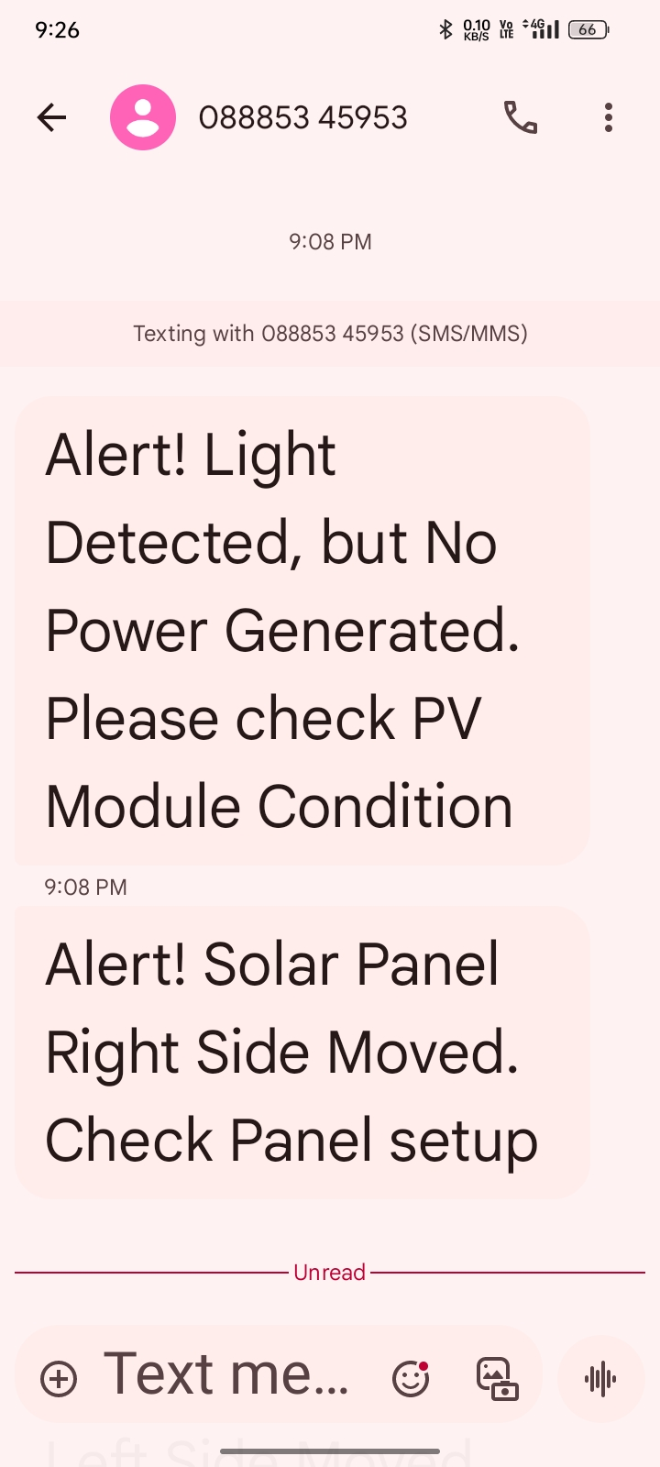
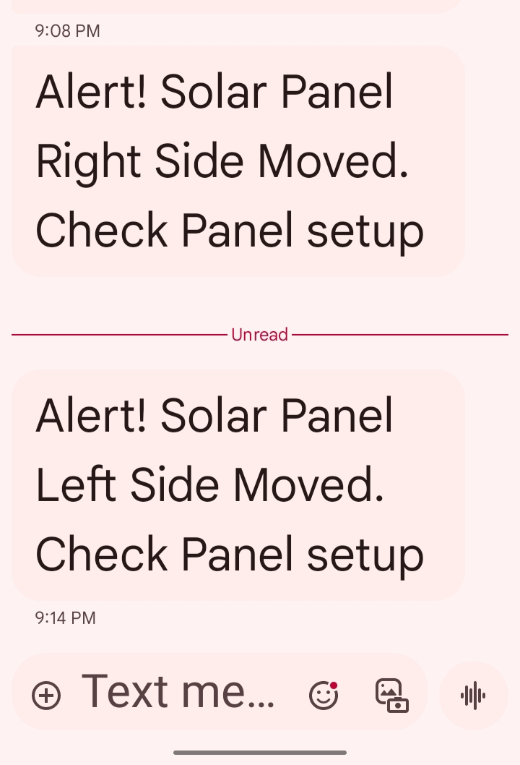
Results & Test Cases
The system enhances solar energy efficiency and reliability by
enabling real-time fault detection and diagnosis through
comprehensive monitoring and timely alerts.
Test Cases :
1. For Module position changed : “Alert ! Solar Panel Right Side
Moved.Check Panel setup.
2.For low voltage when there is enough light intensity: “Alert !
Light Detected , but No Power Generated.Please PV Module Condition
3.For temperature rise of Module : “Alert ! High temperature detected”
For these cases the alerts are sent to client mobile through sms.

Slide 9
Need to be done !
Need to integrate with the ThingSpeak , which is a cloud – based Iot analytics platform that allows us to collect, store, visualize,and analyize data from internet connected devices

Slide 10
References
Long-Dong, Y. -K. Wu and M. -H. Pham, "Fault identification and diagnosis methods for photovoltaic system:A review," 2021 7th International Conference on Applied System Innovation (ICASI), Chiayi, Taiwan, 2021
G. G. Kim, W. Lee, B. G. Bhang, J. H. Choi and H. -K. Ahn, "Fault Detection for Photovoltaic Systems Using Multivariate Analysis With Electrical and Environmental Variables," in IEEE Journal of Photovoltaics, vol. 11, no. 1, pp. 202-212, Jan. 2021
W. Rezgui, H. Mouss, N. Mouss, D. Mouss, M. Benbouzid and Y. Amirat, "Photovoltaic module simultaneous open-and short-circuit faults modeling and detection using the I–V characteristic," 2015 IEEE 24th International Symposium on Industrial Electronics (ISIE), Buzios, Brazil, 2015
Miao, W., Lam, K. H., & Pong, P. W. (2020). A string-current behavior and current sensing-based technique for photovoltaic line–line fault detection in systems. IEEE Transactions on Magnetics, 57(2),1-6
Dr.K.Dhayalini, S.A.Priyadarshini, “Â MEMS multisensory based intelligent damage detection for wind turbines”, International Journal of computer and mathematical sciences, Volume 6, Issue 11, pp.181-189
Abd el-Ghany, H. A., ELGebaly, A. E., & Taha, I. B. (2021). A new monitoring technique for fault detection and classification in PV systems based on rate of change of voltage-current trajectory. International Journal of Electrical Power & Energy Systems, 133.

Slide 11
THANK YOU

